Slide 1
Database Management and Analysis
on Yelp Dataset
Ran Wei & Rui Zhang

Slide 2
OUTLINE
Introduction
Use Case 1: Social Network
Use Case II: Business Reputation Analysis
Future Work

Slide 3
Introduction

Slide 4
10+ GB
100,000,000+
50+
160,000+ businesses
JSON files
7,000,000+ reviews
Records
200,000+ users
Columns

Slide 5


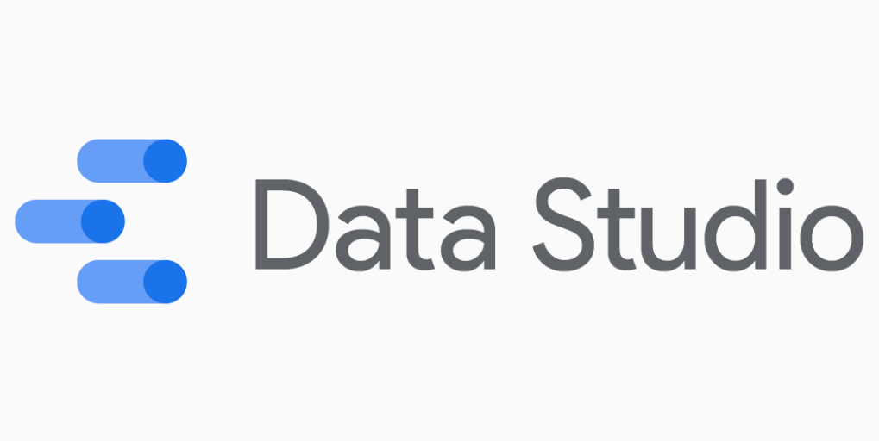





Server
Database
Query
Visualization

Slide 6
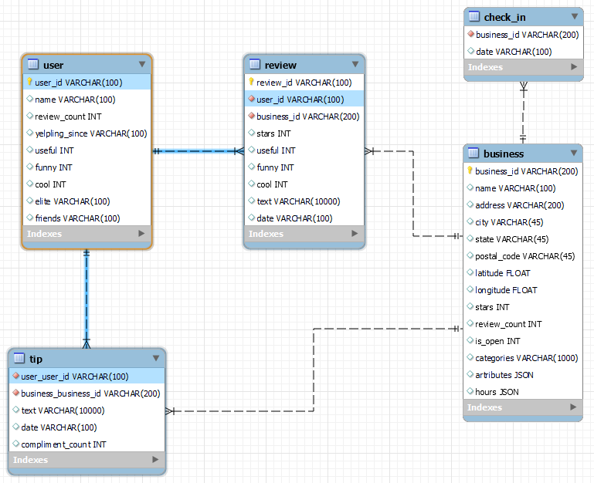
IMPORT DATA TO MYSQL DATABASE
EER Diagram

Slide 7
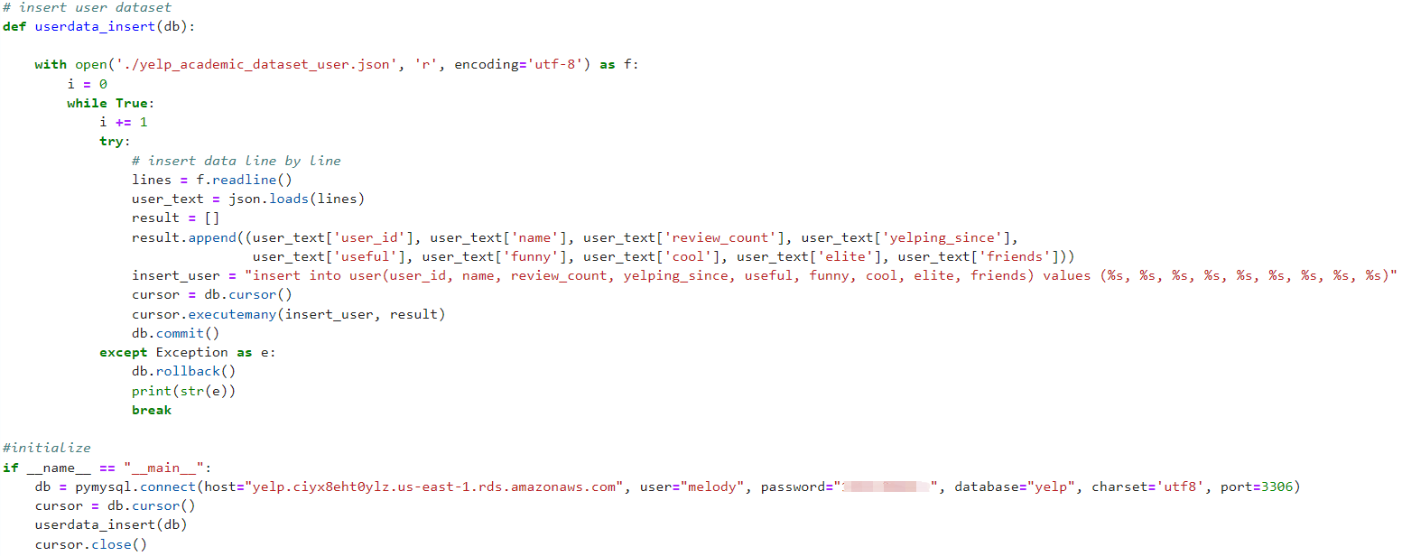
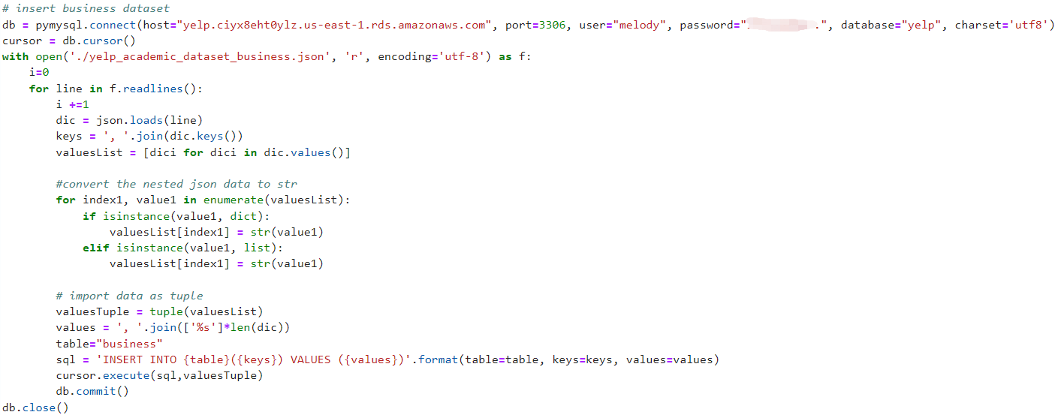

Slide 8
Use Case I: Social Network

Slide 9

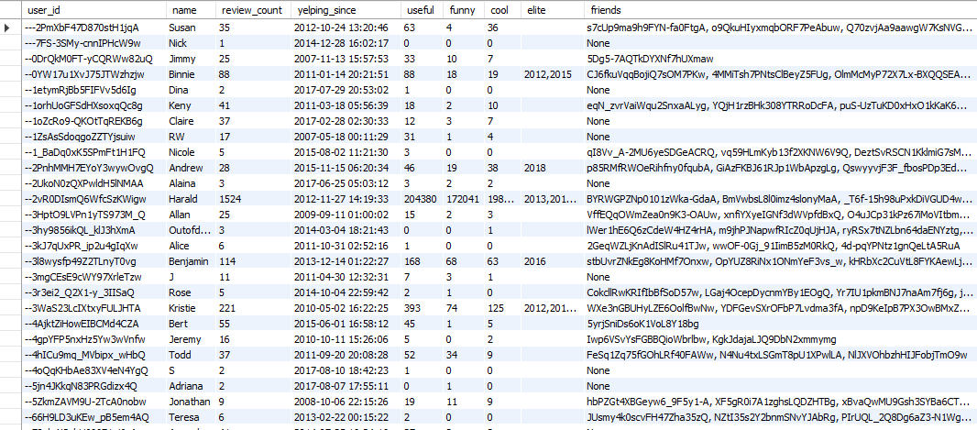
IMPORT DATA TO ARANGODB OASIS
MySQL table: ‘user’

Slide 10
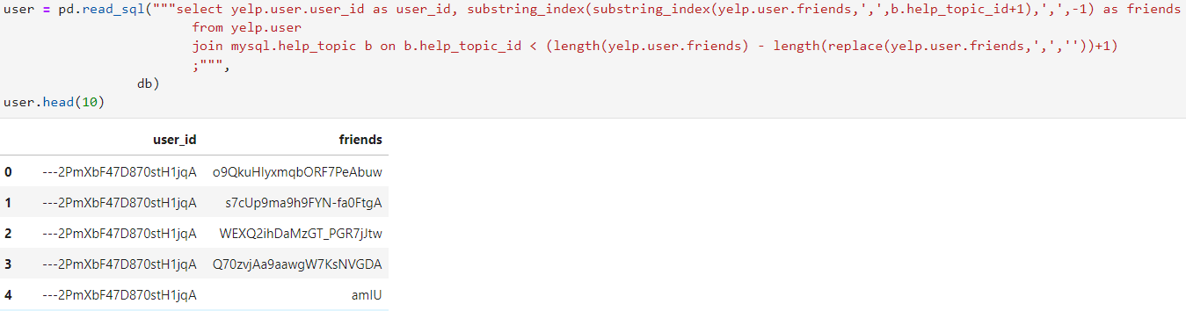
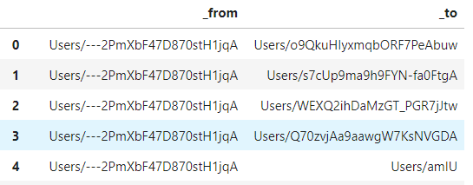
IMPORT DATA TO ARANGODB OASIS

Slide 11
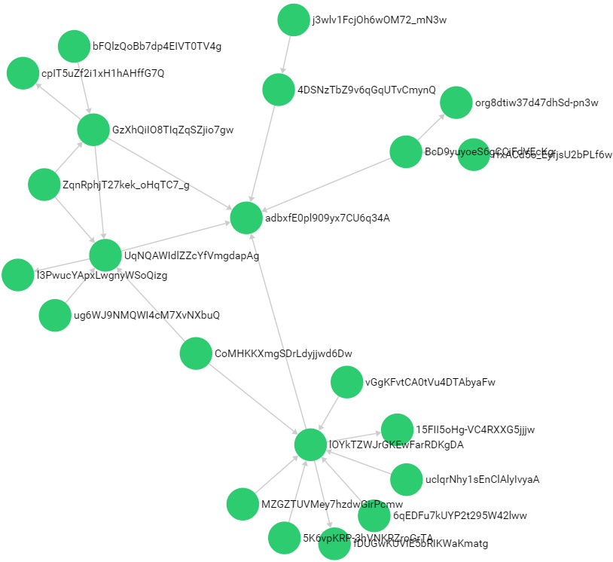
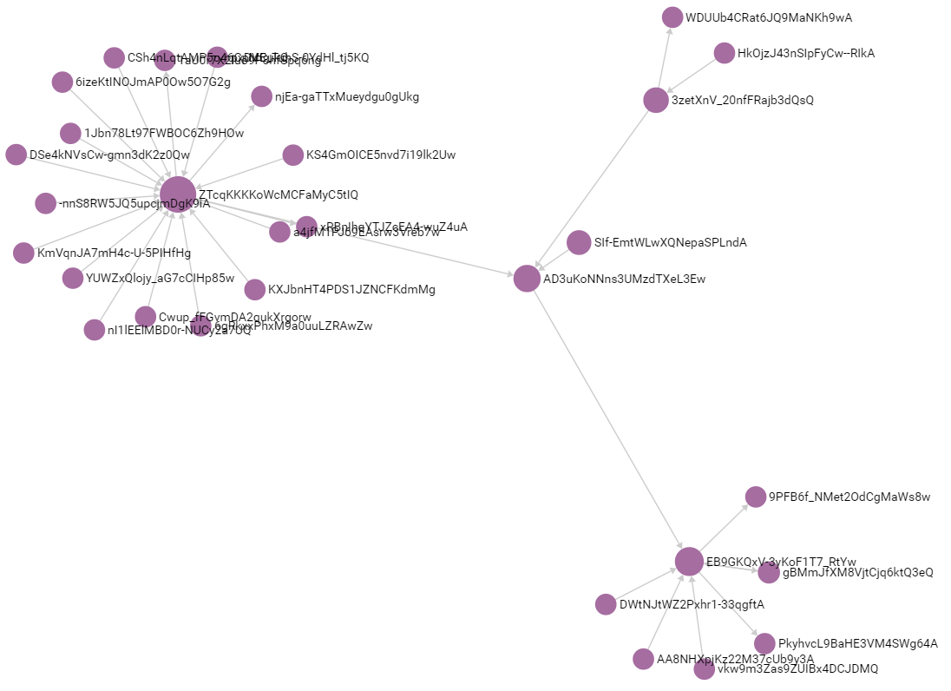
IMPORT DATA TO MYSQL DATABASE

Slide 12
Use Case II: Business Reputation Study

Slide 13
Business Reputation
for Massachusetts
Reviews
Check-in
Stars
Reviews Table
Check-in Table
Business Table
NLP
pandas
average
sentiment score of reviews
check-in counts
stars of the business

Slide 14
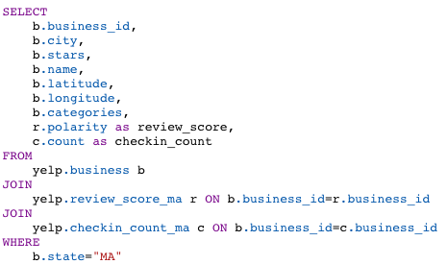
Query to join the tables

Slide 15
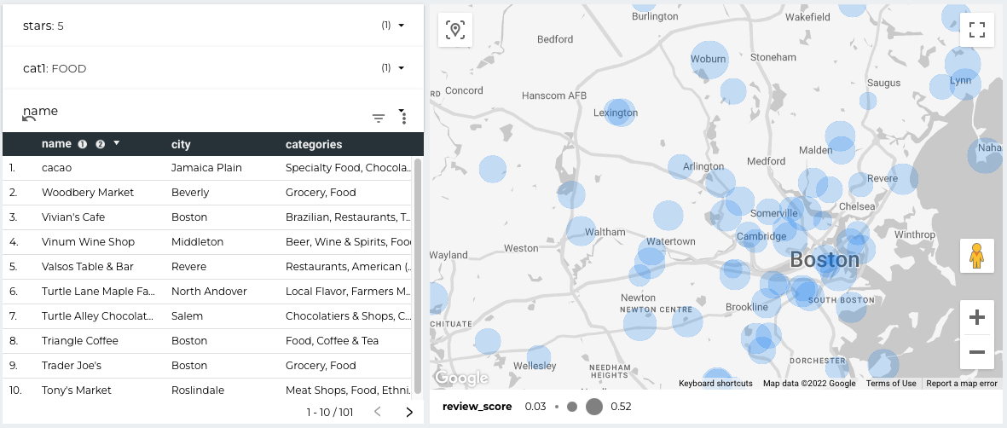
An analytics tool using google data studio

Slide 16
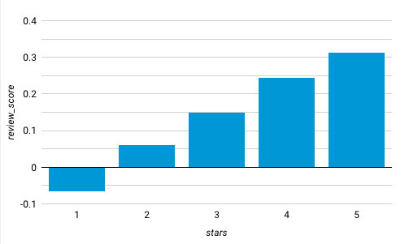
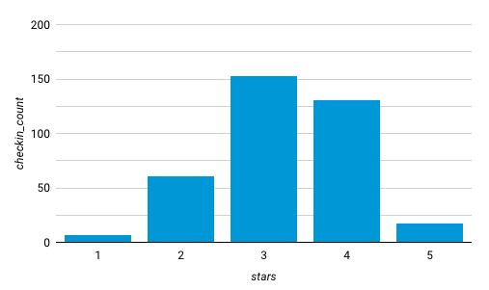
• The average review scores for each level of stars.
• Review score is increasing with stars.
• The average number of check-ins for each level of stars.
• More check-ins happened on the average rated businesses.

Slide 17
Future Work

Slide 18
Current data uploading is slow. Explore faster options to upload the data to cloud
Combine SNA with Text Analysis
Extend the analysis from MA to all states in the US
Create a recommendation system based on the data

Slide 19
THANKS!
Questions?

